Slide 1

Electricity Demand and Price Forecasting using Machine Learning Techniques
This presentation examines the application of machine learning techniques for forecasting electricity demand and price. It delves into the methodologies, results, and implications of using Long Short-Term Memory (LSTM) and Random Forest models for accurate energy management and trading.

Slide 2
CONTENTS
1
Abstract
2
Introduction
3
Literature Review
A concise overview of the project's scope, methodology, and key findings.
A discussion of the context, significance, and objectives of the research.
A comprehensive review of existing studies and approaches to electricity demand and price forecasting.
4
Methodologies
5
Result
6
Conclusion
A detailed description of the data used, preprocessing techniques, and model implementation.
An analysis of the performance metrics and visualizations of the model results.
A summary of the key findings, implications, and recommendations.
7
References
A list of cited sources used in the project.

Slide 3
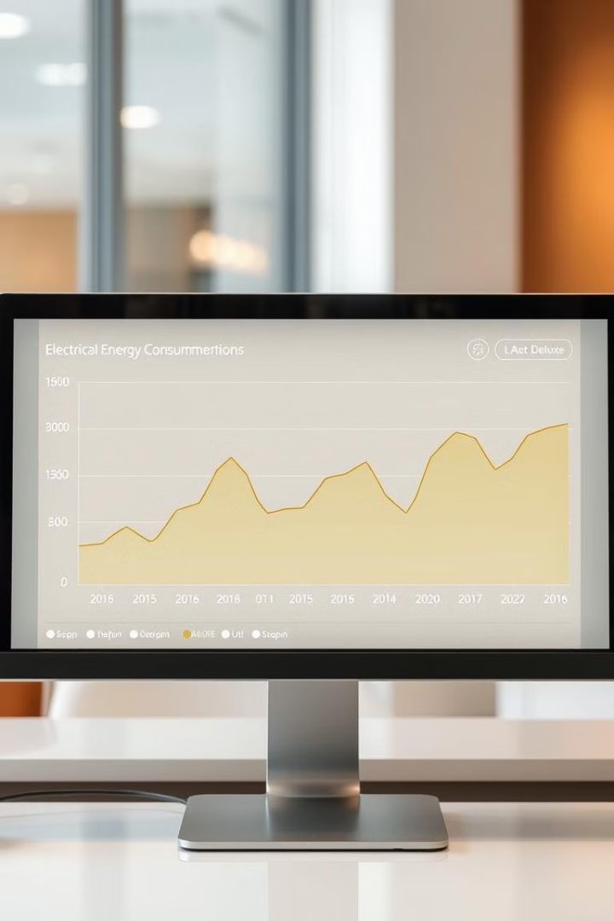
Abstract
This research presents a comparative study of machine learning models for electricity demand and price forecasting. Utilizing a Kaggle dataset encompassing 2106 days, the project trains and evaluates Long Short-Term Memory (LSTM) and Random Forest models. Results demonstrate that the LSTM model achieves an accuracy of 96.74%, surpassing the Random Forest model with an accuracy of 94.4%. The study highlights the potential of LSTM for accurate and reliable energy forecasting, contributing to enhanced power grid management, energy trading, and economic planning.

Slide 4

Introduction
Accurate electricity demand and price forecasting is essential for efficient energy management and trading. As electricity demand continues to rise alongside the integration of renewable energy sources, forecasting has become increasingly complex. Traditional forecasting methods struggle to handle the intricate dynamics of modern energy markets. This project aims to explore the potential of machine learning techniques to enhance the accuracy of electricity demand and price forecasting.
Objective
To develop a reliable and accurate predictive model for electricity demand and price forecasting utilizing machine learning techniques, specifically Long Short-Term Memory (LSTM) and Random Forest (RF) models, ultimately improving energy management and trading efficiency.

Slide 5
Literature Review
The field of electricity demand and price forecasting has been the subject of extensive research in recent years. Various studies have explored different approaches to enhance forecasting model accuracy. Traditional methods such as autoregressive integrated moving average (ARIMA) models, exponential smoothing (ES) models, and regression analysis have been widely employed due to their simplicity. However, these methods have limitations in handling non-linear relationships and complex patterns within the data.
Traditional Methods
Machine Learning Methods
ARIMA, ES, Regression analysis - Simple but struggle with non-linearity.
ANNs, SVMs, RFs - Capable of handling non-linear relationships and complex patterns.
In recent years, machine learning techniques have gained prominence in electricity demand and price forecasting. Studies have demonstrated that machine learning models like artificial neural networks (ANNs), support vector machines (SVMs), and random forests (RFs) often outperform traditional methods in terms of accuracy. These models are well-suited for forecasting due to their ability to handle non-linear relationships and intricate data patterns. This study seeks to contribute to the existing literature by investigating the potential of LSTM and RF models for electricity demand and price forecasting.

Slide 6

Methodologies
The project utilizes a dataset from Kaggle, covering 2106 days between January 1st, 2015, and October 6th, 2020. This comprehensive dataset contains 14 columns, encompassing demand, retail spot prices (RRP), weather conditions, and other relevant factors.
Data
Demand
RRP
Demand_pos_RRP
RRP_negative
Demand_neg_RRP
RRP_Positive
Frac_at_neg_RRP
Min_temperature
Max_temperature
Solar_exposure
Rainfall
School_day
Holiday
The dataset undergoes preprocessing, converting the date column into day, month, year, and day of the week. Scaling using Min-Max Scaler, handling missing values, and encoding categorical values are performed. After preprocessing, the total number of columns is expanded to 18.

Slide 7
Data Visualization
Visualizing the data is crucial for understanding relationships between variables and informing modeling decisions. The project employs various plots to gain insights into the dataset:
1
Scatter Plots
2
Box Plots
3
Joint Plots
Visualize relationships between demand and variables like max-temperature, RRP, and solar exposure.
Analyze demand patterns based on day of the week, school days vs. holidays.
Examine the relationship between demand and RRP.
4
Histograms
5
Correlation Heat Map
Analyze the distribution of demand and temperature values.
Visualize the correlation between all variables in the dataset.

Slide 8
Model Implementation
The dataset is split into training and testing sets using the train_test_split function from Scikit-learn. Two machine learning models, LSTM and Random Forest, are implemented and compared.
LSTM (Long Short-Term Memory)
Random Forest
A type of Recurrent Neural Network (RNN) designed to handle the vanishing gradient problem. LSTMs are particularly well-suited for modeling temporal relationships in data, such as time series data. The LSTM model is implemented using the Keras library. It consists of an input layer, an LSTM layer, and an output layer.
An ensemble learning method that combines multiple decision trees for a more robust and accurate prediction model. Implemented using the Scikit-learn library. The model consists of an ensemble of decision trees.

Slide 9

Results
Both models are evaluated using a range of metrics to assess their performance: MAE (Mean Absolute Error), MAPE (Mean Absolute Percentage Error), R-squared, RMSE (Root Mean Squared Error), and Accuracy.
Model
MAE
MAPE
R^2
RMSE
Accuracy
Random Forest
0.0092434
5.597700
0.9717205
0.0257910
94.40229
LSTM
0.0077986
3.258611
0.9993664
0.01220777
96.741388
The results demonstrate that the LSTM model achieves superior performance with a higher accuracy of 96.74%, significantly outperforming the Random Forest model with an accuracy of 94.4%.

Slide 10

Conclusion
This study concludes that the LSTM model effectively predicts electricity demand and price with higher accuracy than the Random Forest model. This finding has significant implications for utilities, policymakers, and energy market participants. The use of machine learning models, particularly LSTM, can enhance the accuracy of forecasting, leading to improved resource allocation, pricing strategies, and overall energy efficiency.
The study emphasizes the potential of machine learning for addressing complex energy management challenges. Further research can explore the integration of advanced machine learning techniques, such as ensemble methods and deep learning architectures, to further enhance forecasting accuracy and contribute to sustainable energy practices.

